Slide 1
Artificial Intelligence
PRITHISH Negi
Oct 11, 2018

Slide 2
What is Artificial Intelligence
Artificial intelligence (AI) is the intelligence exhibited by machines or software. It is also the name of the academic field of study which studies how to create computers and computer software that are capable of intelligent behavior.
Its goal is to enable the development of computers that are able to do things normally done by people -- in particular, things associated with people acting intelligently.

Slide 3
Types of AI
Strong AI
The goal is to simulate how humans reason, build systems that think and can also explain how humans think.
General AI
The system can reason in general
Weak AI
The system will behave like humans, but the results do not inform us on how they were achieved.
Narrow AI
The system is intended for specific tasks

Slide 4
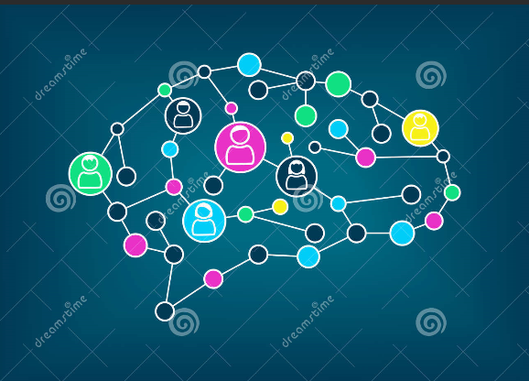
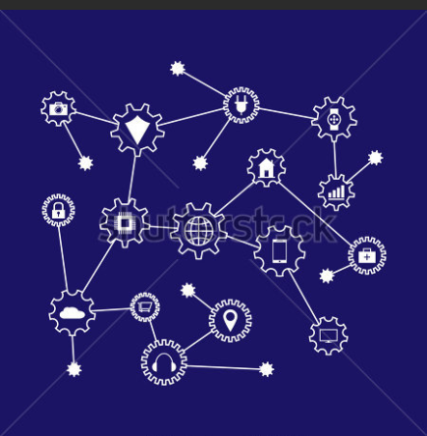
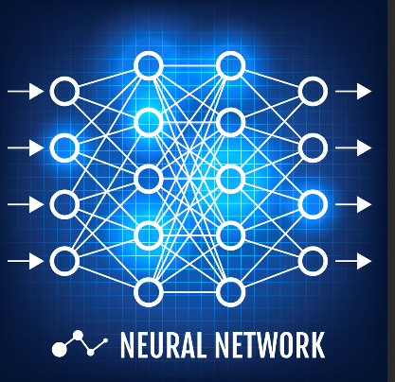
AI, Machine Learning and Deep Learning
Ar
ARTIFICIAL INTELLIGENCE
A
Engineering of making intelligent machines and programs
MACHINE LEARNING
Ability to learn without being explicitly programmed
DEEP LEARNING
Learning based on deep neural networks

Slide 5
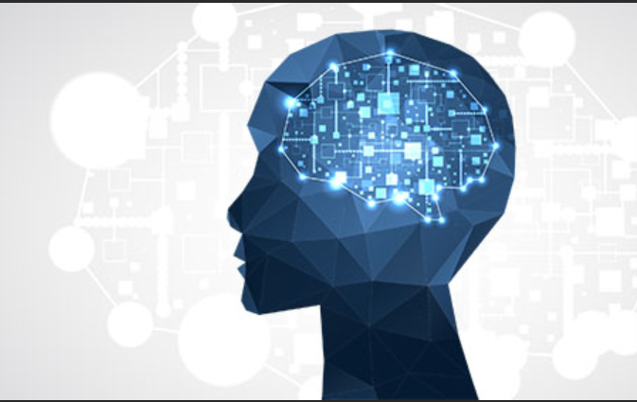
Machine Learning
Machine learning is a subfield of computer science that evolved from the study of pattern recognition and computational learning theory in artificial intelligence.
In 1959, Arthur Samuel defined machine learning as a "Field of study that gives computers the ability to learn without being explicitly programmed".

Slide 6
Types of Machine Learning
Based on purpose, Machine Learning can be divided into 3 main groups
Regression
Supervised
Similar to a teaching a student with examples
The algorithm learns from example data and the associated target responses
Unsupervised
The algorithms learns from plain examples without associated target responses.
The algorithm determines the data pattern on its own
Reinforcement
The algorithm is trained using examples without labels, but provide positive or negative feedback based on the solution proposed.

Slide 7
Supervised Learning
Input
Training
Output
Basics
The learning is done explicitly
Data, with clearly defined output is used for training
Direct feedback is provided to improve learning
Used to predict outcome/future
Uses Regression and Classification algorithms
Business Examples
Fraud Detection
Calculating life time value
Recommendation Engines
Forecasting and Predictions
Algorithms
Classification
Support Vector Machines
Discriminant Analysis
Naïve Bayes
Nearest Neighbor
Neural Network
Regression
Linear Regression
GVR
Decision Trees
Ensemble Methods
Neural Networks
Business Usage
Fraud Detection
Calculating life time value
Recommendation Engines
Forecasting and Predictions
Medical Imaging

Slide 8
Unsupervised Learning
Input
Output
Basis
The algorithm independently understands the data
The algorithm identifies patterns/structures within the data
The evaluation is qualitative or indirect
The algorithm does not predict anything specific
Business Usage
Anomaly detection
Image Processing
Text Processing
Audio Processing
Targeted Marketing
Customer Segmentation
Algorithms
Clustering
K Means/Fuzzy C Means
Hidden Markov Model
Hierarchical
Gaussian Mixture
Neural Networks

Slide 9
Reinforcement Learning
Rewards
Input
Output
Basics
Rewards based learning system
Learning is based on positive and negative reinforcements
Machine learns how to behave in certain environments
The goal is to maximize rewards
Business Usage
Gaming AI
Robot Navigation
Real Time Decisions
Skill Acquisition
Driverless cars
Optimized Marketing
Algorithms
Q Learning
Sarsa
Markov Decision Process

Slide 10
Another way of classifying Machine Learning
Learning by examples
Learning by experience
Self Learning
Deep Learning

Slide 11


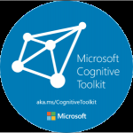


Popular Open Source Frameworks for AI
Theano
Python library designed for deep learning
Helps define, optimize, and evaluate mathematical expressions involving multi-dimensional arrays
Optimized for both CPU and GPU
Microsoft Cognitive Toolkit
A deep learning framework
Uses neural networks to go through large datasets of unstructured data
Highly customizable
Written in Python and C++
Allows you to choose your own parameters, algorithms, and networks
more popular in the speech recognition arena
Keras
Written in Python
Runs on top of other frameworks such as TensorFlow, Microsoft Cognitive Toolkit, Theano
Designed to promote experimentation with multiple frameworks
TensorFlow
Google developed
Used for Deep Learning & Neural Networks
Creates graphs in C++ and Python
Uses data flow graphs
Supports a wide variety of platforms
(GPU, CPU, TPU)
Caffe
Convolutional Architecture for Fast Feature Embedding
Very fast, powerful, and efficient deep learning framework
Written in C++ and supports Python
Heavily used for image classification and segmentation
Supports CNN, RCNN, LSTM and fully connected neural network designs

Slide 12
Appendix

